Slide 1






HOSTING A STATIC WEBSITE USING AWS

Slide 2


Amazon web service
Elastic Compute Cloud (Ec2) With
the help of Ec2 Amazon Linux Run
And install the Apache Server to host the website in linux . And Finding the path of the apache and Making file permission for that directory then Web hosting Using WinSCP.
Hostinger is a Platform for To purchase an Private Domain. We are Going to use this Platform to Purchase an Private To run the Website and configuring the private domain with the Route 53 service the service which is used particularly for the domain name .
HOSTINGER
EC2
Using “ AMAZON WEB SERVICE “
Hosting a Static Web Page and
With the help of Amazon Linux
“EC2” and Configuring with the
Private Domain with the help of
Route 53 and Routing Policies
to avoid server Downtime

Slide 3






ARCHITECTURE :-
OUTPUT
WinSCP
EC2
SERVER
PUTTY
HOSTINGER
ROUTE 53
Amazon Linux

Slide 4
Explanation :
Hosting a static Webpage With the help of Amazon web service (AWS) . For this
Project the services we are going to use is Elastic compute Cloud (Ec2) which is used
To Run Multiple different Operating System (OS) remotely at low cost ,So here we are
Going to Run the Amazon Linux and install the Apache server for webpage hosting
Apache is a HTTP Server it is widely used to deliver web content over the internet .
Meanwhile it is Open source Software Then With the help of tool WinSCP we are
Going to Transfer the HTML code From windows to Linux , Here WinSCP is Basically used to
Transfer the File among different OS . Route 53 This service is used particularly
for Private Domain Configuring , Here we are going to Purchase a Private domain
Using Hostinger Platform and configuring the Purchased domain with the Route 53
Service to reduce the server downtime we are going to add Routing policies .

Slide 5



Technology used :
Amazon Web Service
HOSTINGER
HTML
EC2
Amazon Linux
WinSCP
Route 53
PUTTY
SERVER

Slide 6
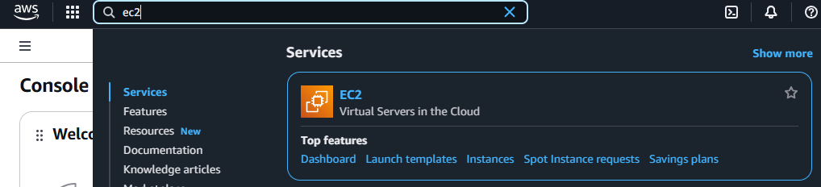
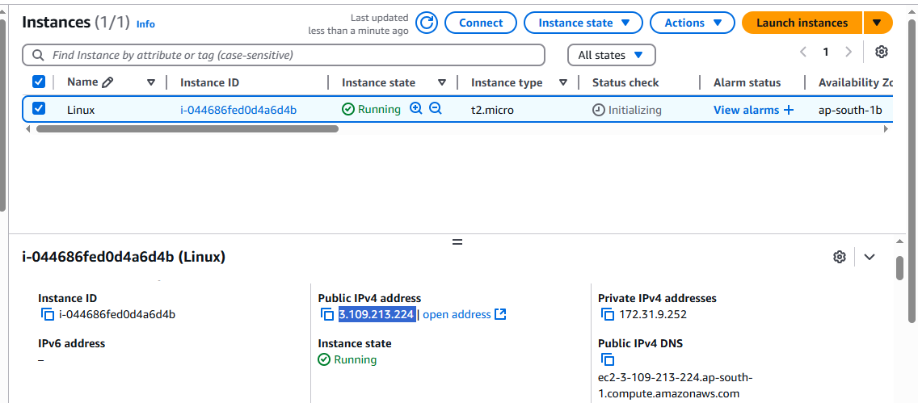
Working Sample :

Slide 7
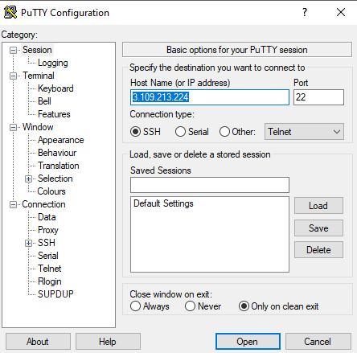

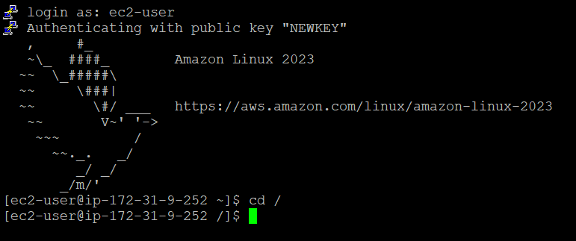

Slide 8
APACHE INSTALLATION
Changing as Root User
sudo – i
cd /
Yum install httpd –y
systemctl start httpd
systemctl status httpd
Change Directory
Installing Apache
Starting Apache server
Status check for apache
Chmod 777 /var/html/www
File Permission for apache directory
Touch index.html
File contain source code

Slide 9
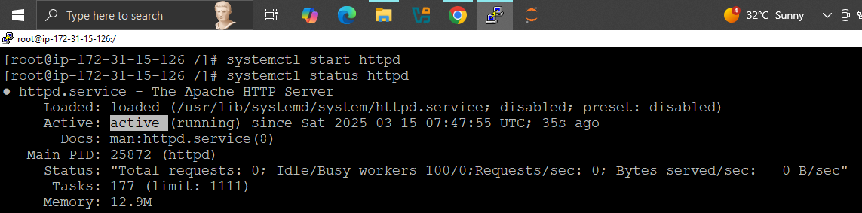

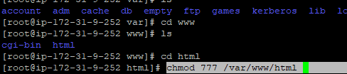
APACHE INSTALLATION :
FILE PERMISSION :

Slide 10

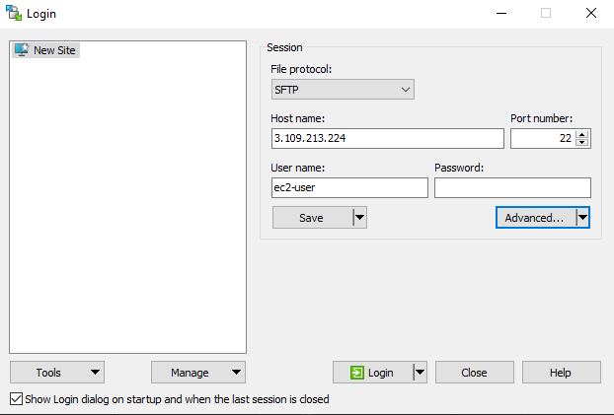
CONNECTING WINSCP
WinScp is a software used to
Transfer data and files
among different OS without any
difficulties.
WinScp in connect to the
specific OS through
IP address and Security key,

Slide 11
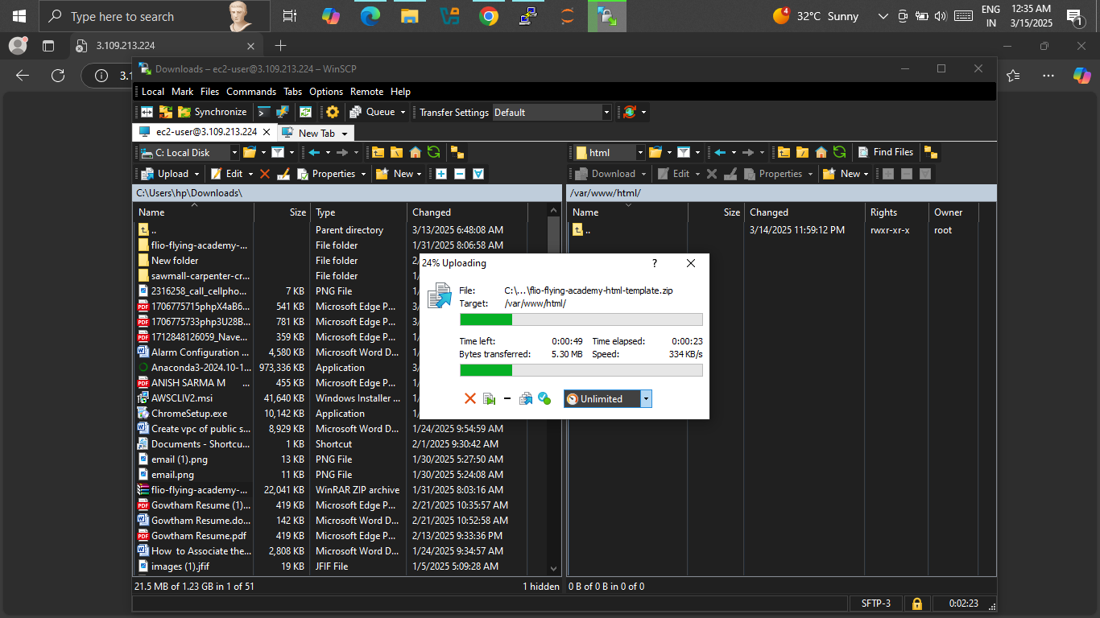


SOURCE CODE TRANSFER VIA Winscp

Slide 12

SOURCE CODE
<!DOCTYPE html>
<html lang="en">
<head>
<meta charset="UTF-8" />
<meta name="viewport" content="width=device-width, initial-scale=1.0" />
<title>Vels University - Home</title>
<!-- Google Fonts -->
<link href="https://fonts.googleapis.com/css2?family=Poppins:wght@400;600&display=swap" rel="stylesheet">
<link href="https://fonts.googleapis.com/css2?family=Cinzel:wght@700&display=swap" rel="stylesheet">

Slide 13

<style>
* {
margin: 0;
padding: 0;
box-sizing: border-box;
font-family: 'Poppins', sans-serif;
}
body {
background-color: #000000;
color: #ffffff;
font-size: 16px;
line-height: 1.6;
}
header {
background-color: #111111;
padding: 20px;
text-align: center;
box-shadow: 0 2px 5px rgba(255, 165, 0, 0.2);
}
.logo {
max-width: 200px;
height: auto;
margin-bottom: 20px;
}
.

Slide 14

@keyframes fadeInSlideUp {
0% {
opacity: 0;
transform: translateY(30px);
}
100% {
opacity: 1;
transform: translateY(0);
}
}
.welcome-message {
background-color: #ff6600;
padding: 50px 20px;
text-align: center;
opacity: 0;
animation: fadeInSlideUp 2s ease-out forwards;
}
.

Slide 15

.aws-title {
font-family: 'Cinzel', serif;
font-weight: 700;
letter-spacing: 1px;
font-size: 2.8em;
text-transform: uppercase;
margin-bottom: 20px;
color: #000000;
}
.nav-bar {
background-color: #222222;
padding: 15px;
text-align: center;
display: flex;
justify-content: center;
gap: 15px;
flex-wrap: wrap;
}

Slide 16

.nav-bar a {
color: #ffffff;
background-color: #ff6600;
padding: 10px 20px;
text-decoration: none;
border-radius: 5px;
font-weight: 600;
font-size: 1em;
transition: background-color 0.3s, color 0.3s;
display: inline-block;
cursor: pointer;
}
.nav-bar a:hover {
background-color: #ffa347;
color: #000;
}
.content {
display: none;
padding: 30px;
background-color: #111111;
border-top: 2px solid #ff6600;
}

Slide 17

.content.active {
display: block;
animation: slideFade 1s ease;
}
@keyframes slideFade {
0% {
opacity: 0;
transform: translateY(20px);
}
100% {
opacity: 1;
transform: translateY(0);
}
}

Slide 18

pre {
background-color: #222222;
padding: 10px;
border-left: 4px solid #ff6600;
overflow-x: auto;
}
.architecture-image {
width: 100%;
max-width: 800px;
height: auto;
border: 2px solid #ff6600;
margin-top: 20px;
}
.tool-icons {
display: flex;
flex-wrap: wrap;
justify-content: center;
gap: 20px;
margin-top: 20px;
}

Slide 19
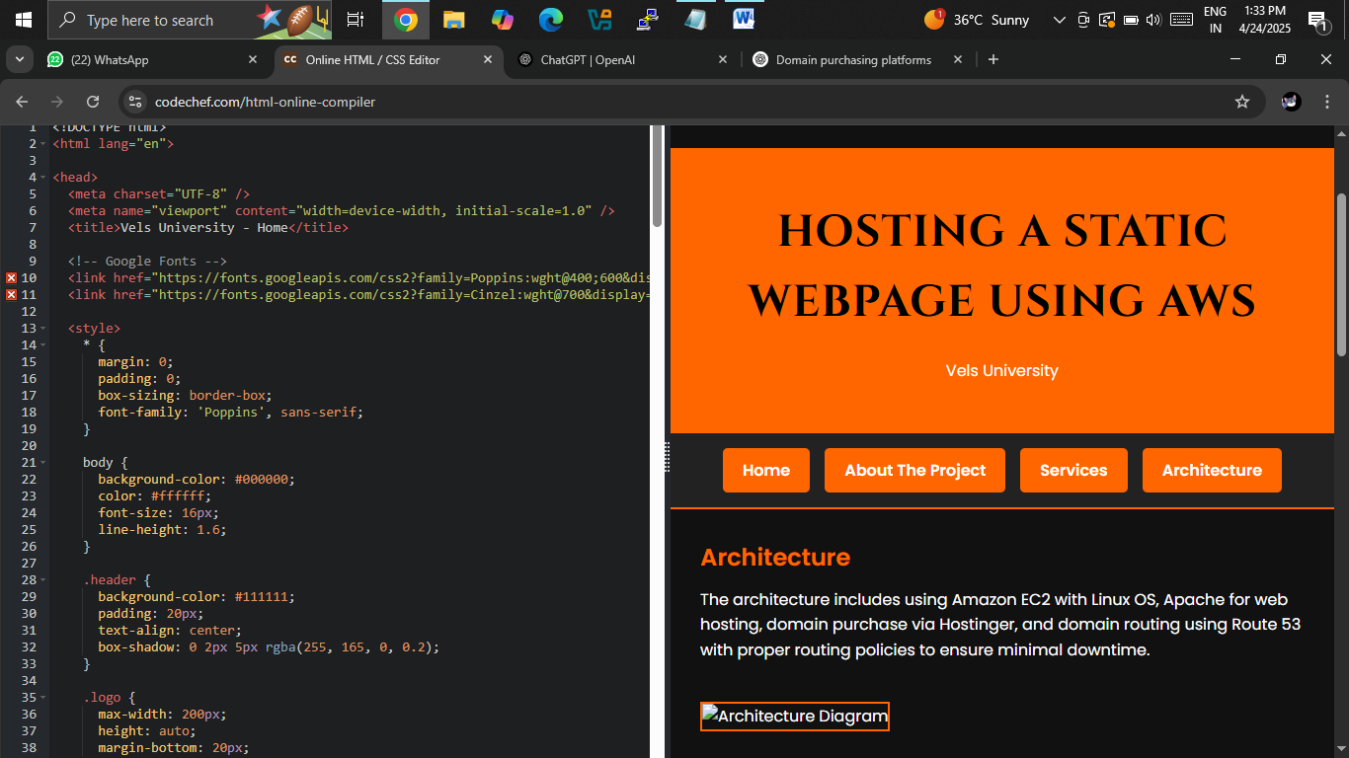
Test page :

Slide 20

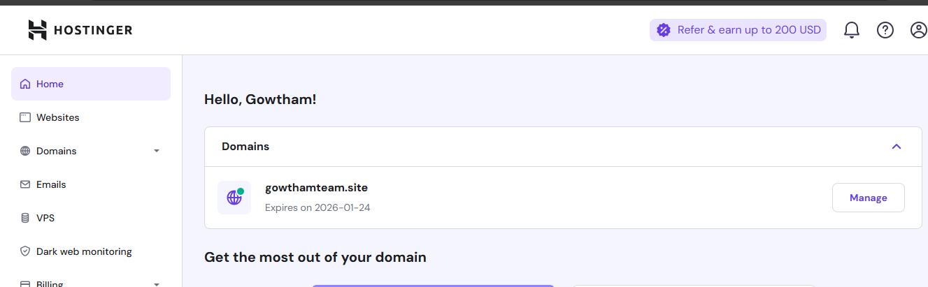
Private domain :
Purchasing Private Domain “gowthateam.site” from hostinger

Slide 21
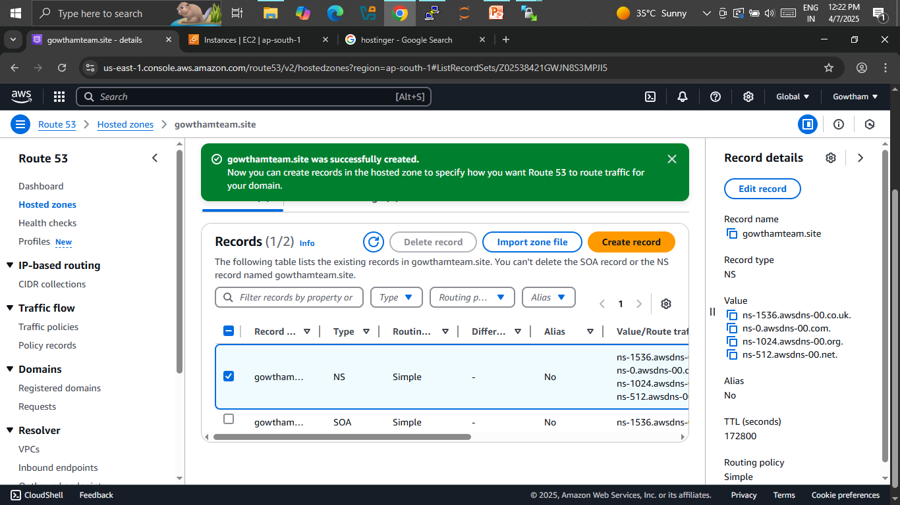
CONFIGURING PRIVATE DOMAIN VIA ROUTE 53

Slide 22
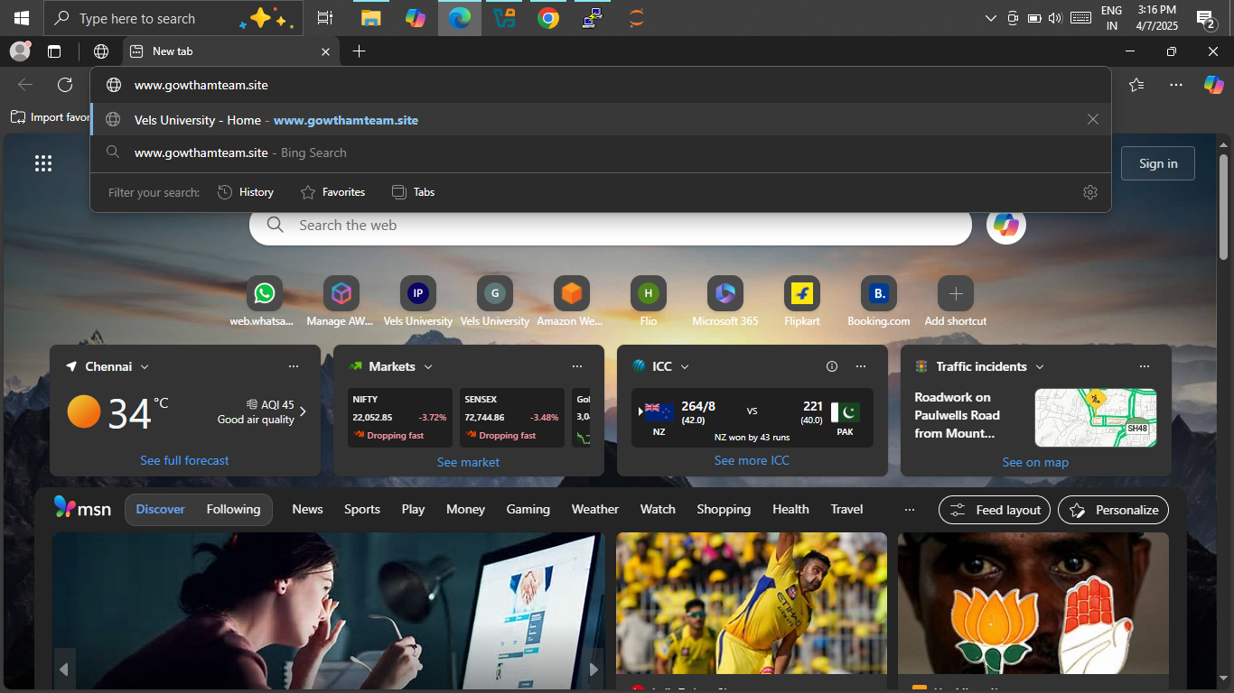

Slide 23
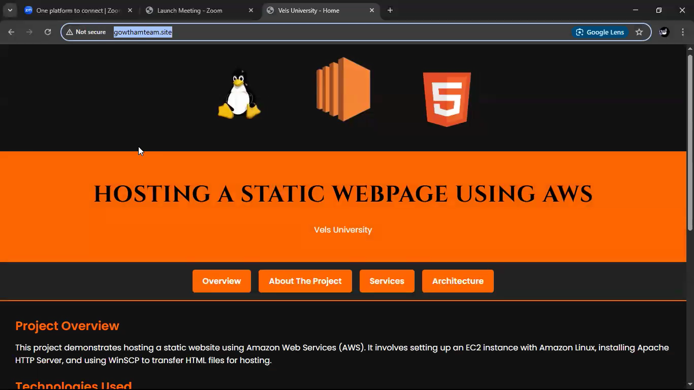
OUTPUT :

Slide 24

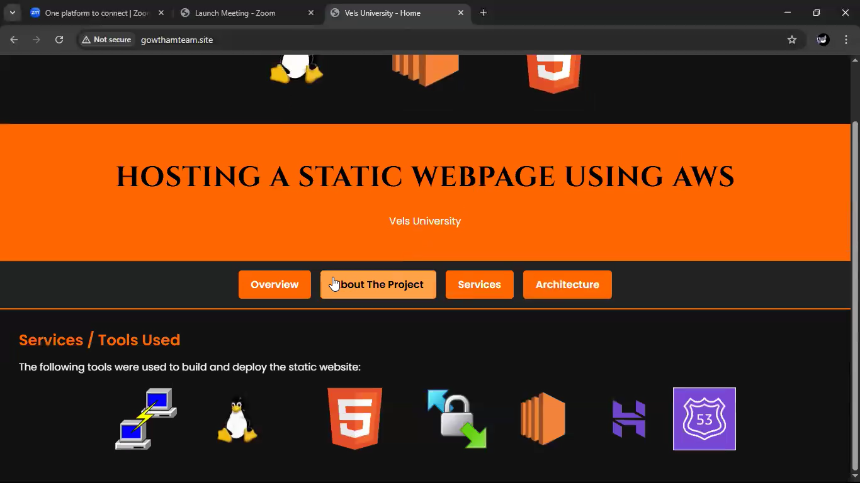

Slide 25
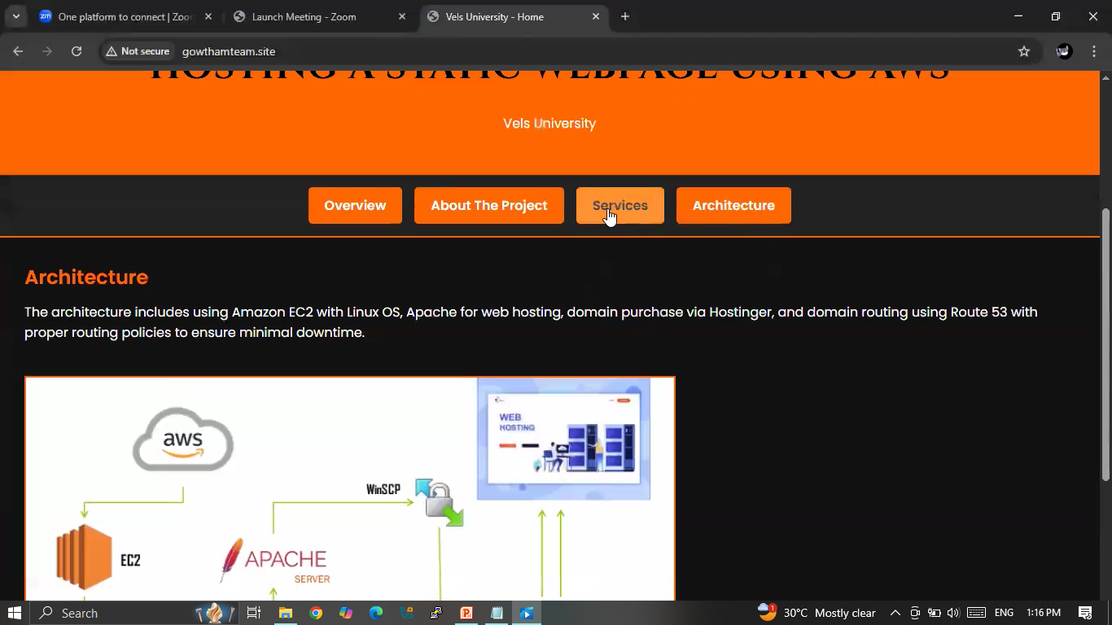

Slide 26
THANK YOU

